Slide 1
Measure the In-tangebles
A study investigating NBA player statistics and developing new performance indicators

Slide 2
What metrics make a player ‘clutch’?
Performance under high pressure situations !
Whet are high pressure situations?
Shot clock, 4th quarter, playoffs
Which metrics appear to have great variability during clutch/high pressure situations?
Passing, shooting, defending – decision making
Different types of players will have different pressures depending on role
Are similar types of players experiencing the same variability?

Slide 3
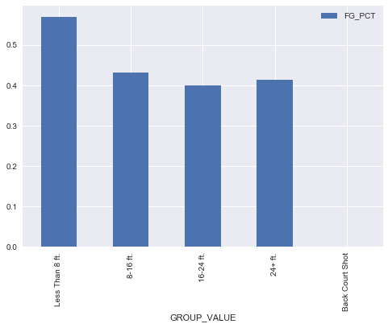
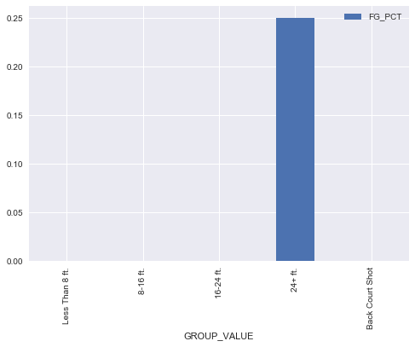
High Pressure situations: Kyle Lowry

Slide 4
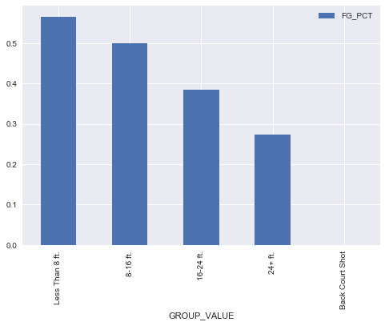
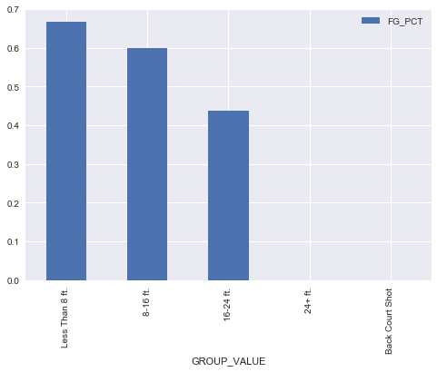
High Pressure situations: DeMar DeRozan

Slide 5
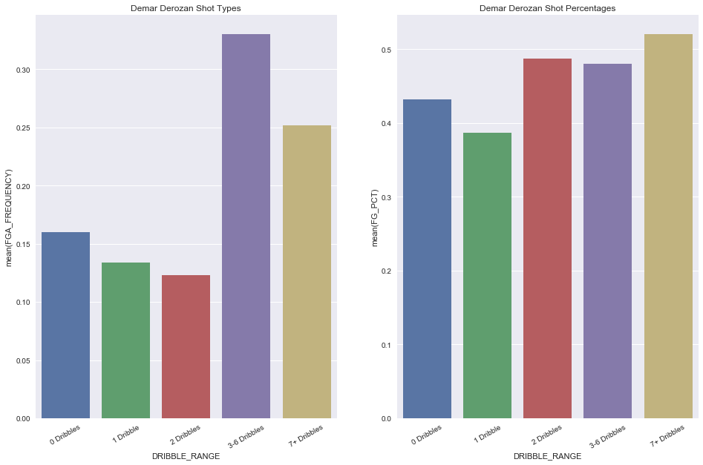
Player Types: DeMar DeRozan

Slide 6
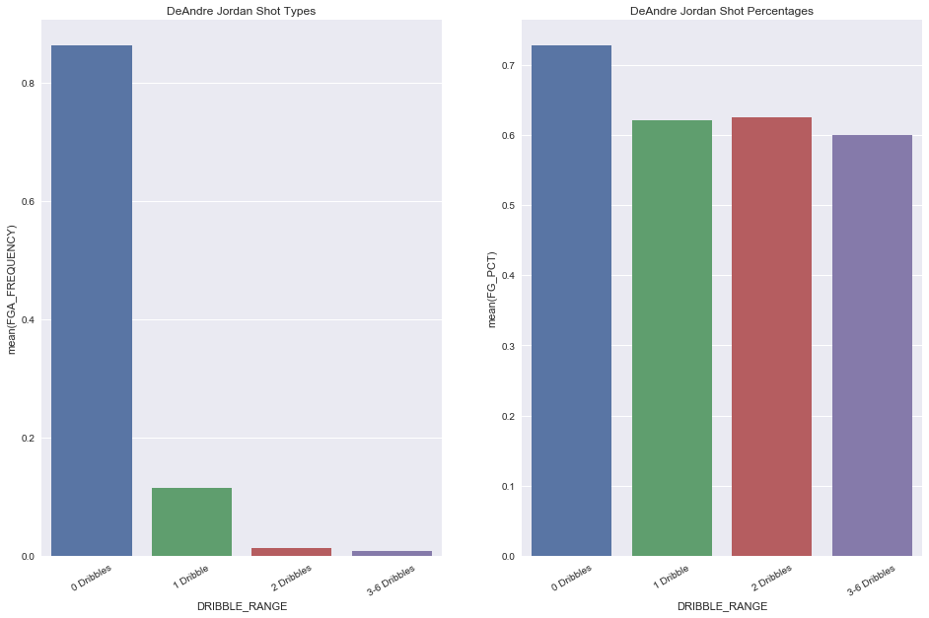
Player Types: DeAndre Jordan

Slide 7
The Goal!
In the end, with separate groups of players, I’d like to create a metric that will incorporate the the role of the player, and their performance under high pressure situations.
Measure the change in specific key stats, tailored towards a player’s role

